Slide 1


Descriptive Analysis
DATA-1-ACADEMY
Module1:
Data Discovery & Data Exploration
©www.everythingondata.com

Slide 2
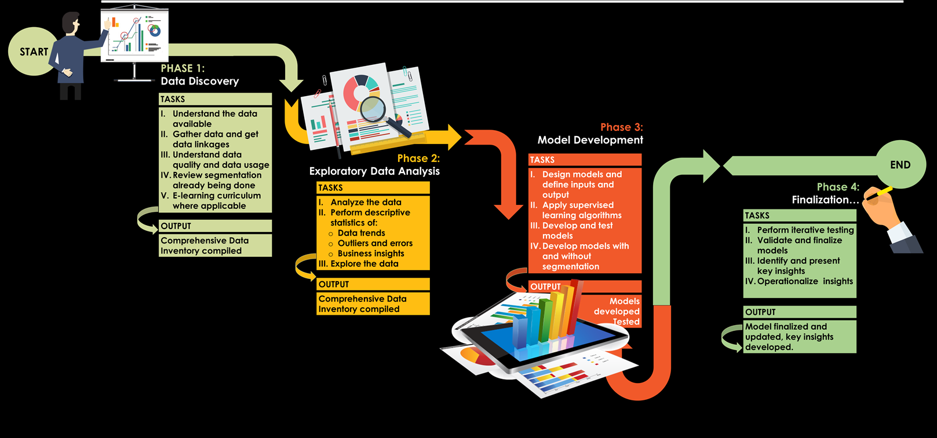
OUR ROADMAP- The 4 Phased Approach to Advanced Analytics
ADVANCED
INTERMEDIATE
©www.everythingondata.com
<number>

Slide 3
ASSESSMENT 1: DATA EXPLORATION
If you are reading this, that means that you have completed the Beginners Class and are on the Intermediate Journey.
CONGRATULATIONS!!!
Next is the Core of Descriptive Analysis: DATA DISCOVERY AND DATA EXPLORATION
EXERCISE:
You are expected to explore the Sample Sales data on Mr Chukwudi Stores with knowledge & wisdom (insights) narratives on discoveries.
Use your excel sheets to plot your charts and post same on this slide.
Minimum no of pages: 10
Maximum no of pages:20
GOODLUCK!
©www.everythingondata.com
<number>

Slide 4
TITLE: Sales by Location
Reason for Analysis: To advice Mr Chukwudi on the best location
Insights: The chart shows that Kebbi state has the highest sales figure with 57.0% of the total sales.
Recommendation: It is advisable to have more establishment in Kebbi State.
©www.everythingondata.com
<number>

Slide 5
TITLE: Sales by People Who Buy His Goods
Reason for Analysis: To advice Mr. Chukwudi on the set of customers to focus more on.
Insights: The chart shows that majority of the customers for the organization are entrepreneur with the highest figure with 52.0% of the total sales from all customers.
Recommendation: It is advisable to focus more on entrepreneur products and source for more entrepreneur.
©www.everythingondata.com
<number>

Slide 6
TITLE: Sales by Products People Buys
Reason for Analysis: To advice Mr. Chukwudi on the products people buys most
Insights: The chart shows that the products or goods customers buys much are fruits and vegetables also snacks foods with 16.0% respectively; after which household products takes 11.0%
Recommendation: It is advisable to focus more on these products that customers patronize more than others.
©www.everythingondata.com
<number>

Slide 7
TITLE: Sales by Times the Products Have High Sales
Reason for Analysis: To advice Mr. Chukwudi on when products sales changes
Insights: The chart shows that the year product sales go up and down. This is to estimate when decline in sales started. It was seen that the lowest sales was recorded in the year 2015 and the highest was recorded in the year 1992. There was a fluctuation in total sales across the years.
Recommendation: It is advisable to study the cause of decline in sales in the respective years where there was decline; also what are the things done differently during the years of high sales recorded.
©www.everythingondata.com
<number>

Slide 8
TITLE: Sales by Supermarket Type
Reason for Analysis: To advice Mr. Chukwudi on the type of supermarket to establish
Insights: The chart shows that the among the supermarket types that have good sales, Supermarket Type 1 brings more sales than other types of supermarket. It shows 70% of total sales is from Supermarket Type 1.
Recommendation: It is advisable to focus more on establishing more Supermarket Type 1
©www.everythingondata.com
<number>

Slide 9
TITLE: Sales by Supermarket Size
Reason for Analysis: To advice Mr. Chukwudi on the supermarket size that brings more sales
Insights: The chart shows that among all the supermarket size, medium Supermarket size has highest sales than other supermarket sizes which account for 68% of total sales is from medium size Supermarket .
Recommendation: It is advisable to focus more on establishing more medium size Supermarket.
©www.everythingondata.com
<number>

